Slide 1
Noisy Channel Model of Spelling

Slide 2
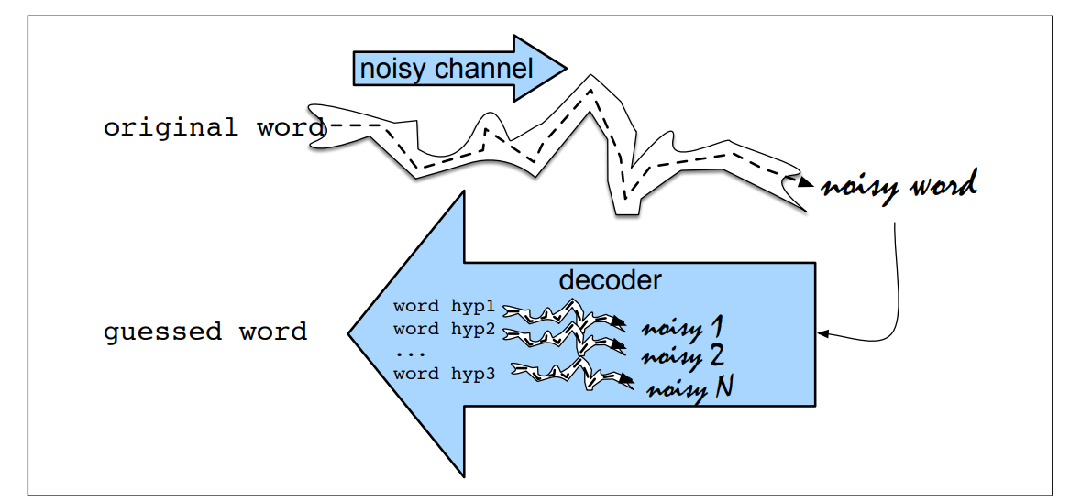
Noisy Channel Intuition
The intuition of the noisy channel model is to treat the misspelled word as if a correctly spelled word had been “distorted” by being passed through a noisy communication channel

Slide 3
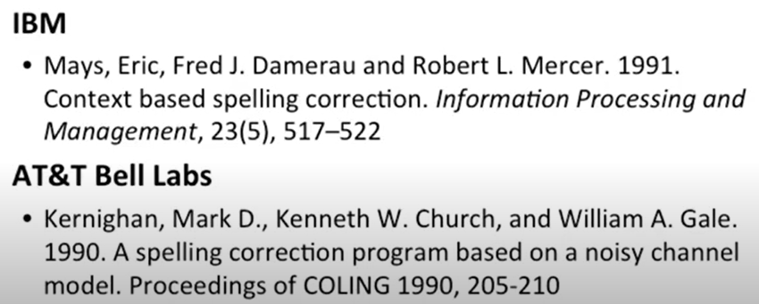
Model proposed around 1990

Slide 4
Bayesian Inference
X : observation as misspelled word
W: which generate this X, find correct word
V: vocabulary (all possible words)
The noisy channel model is maximizing the two factors : language model
P(w|x): likelihood, channel Model, error model
P(w): prior probability of correct word
^: estimate of the correct word

Slide 5



Bayes’ rule to break down conditional probability

Slide 6
Damerau-levenshtein Distance
In general :
Words with similar spelling
Small edit distance to error
Words with similar pronunciation
Small distance of pronunciation
Damerau-Levenshtein
For similar spelling:
Minimal edit distance between two strings, where edits are:
Insertion
Deletion
Substitution
Transposition of two adjacent letters

Slide 7
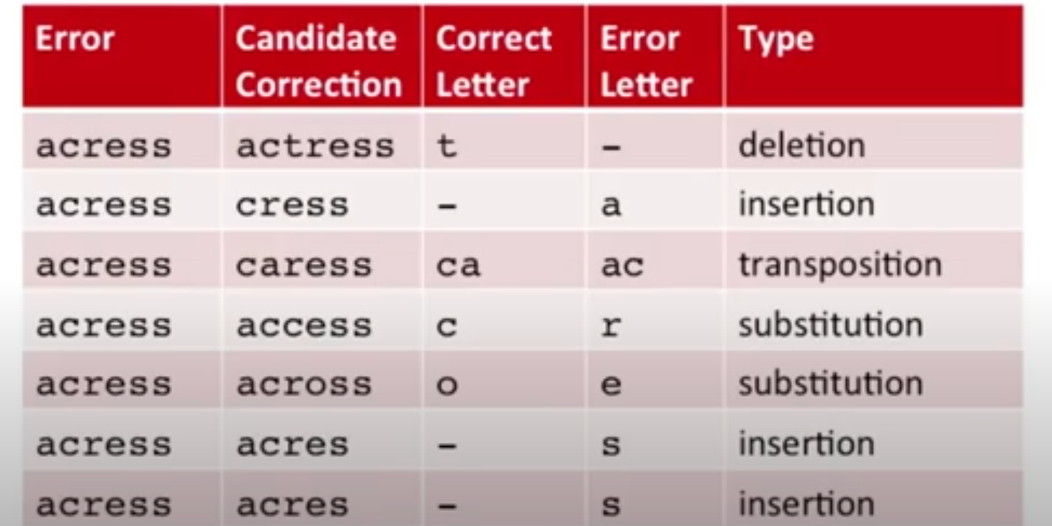
Example: Acress
Applying all such single transformations to acress yields the list of candidate words
80% of errors are within edit distance 1

Slide 8
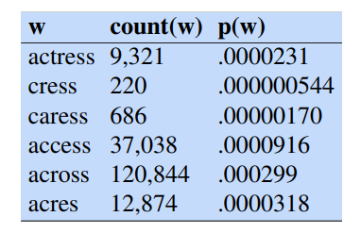
Ranking language model : P(w)
Any algorithms, unigram, bigram, Ngrams
Example: count from 404253213 words in Corpus of Contemporary English (COCA)
Probablity assigned by normalization by language model.

Slide 9
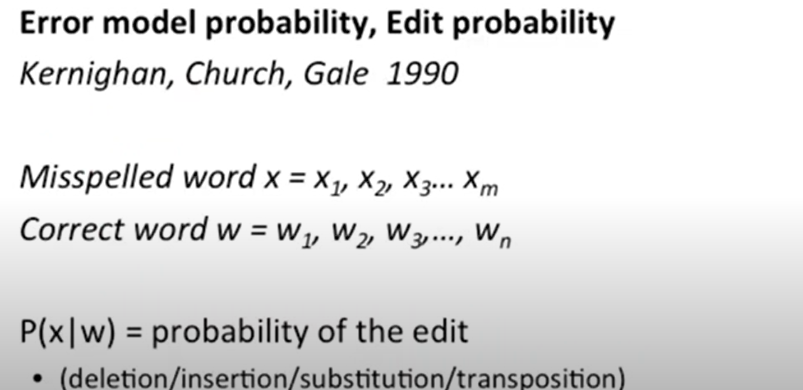
Channel Model Probablity

Slide 10
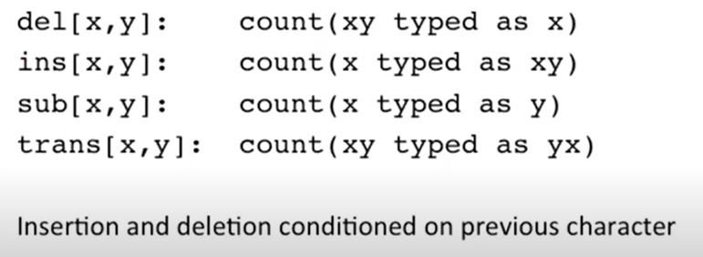
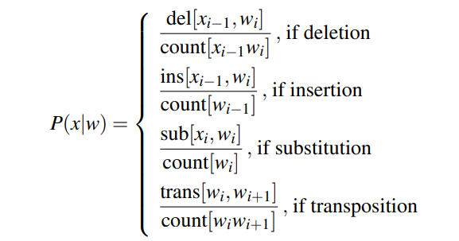
Confusion Matrix
For any given letter , pair of letter how often a letter happen?
How often (count)
Confusion matrix is 26x26 square matrix
List of spell error can be generated
norvig.com/ngrams/spell-errors.txt
Generate probabilities

Slide 11
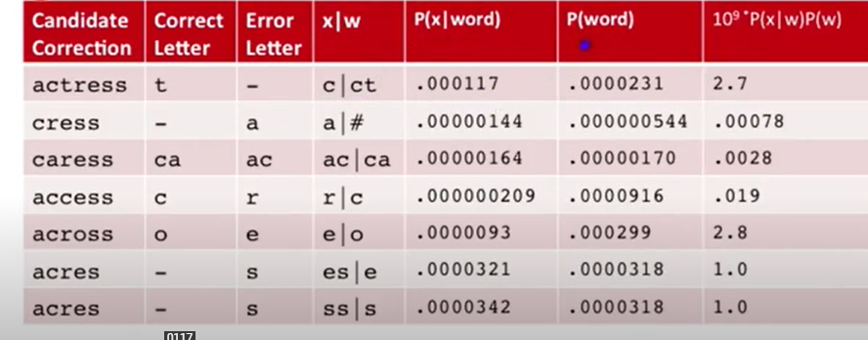
Noisy channel probability for acress

Slide 12
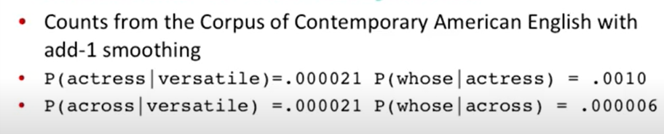
Complete sentence
A stellar and verasatile acress whose combination of saas and glamour.
With Bigram Model

Slide 13
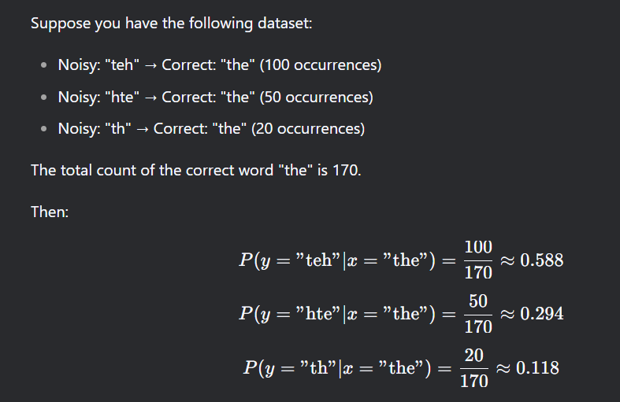

Slide 14
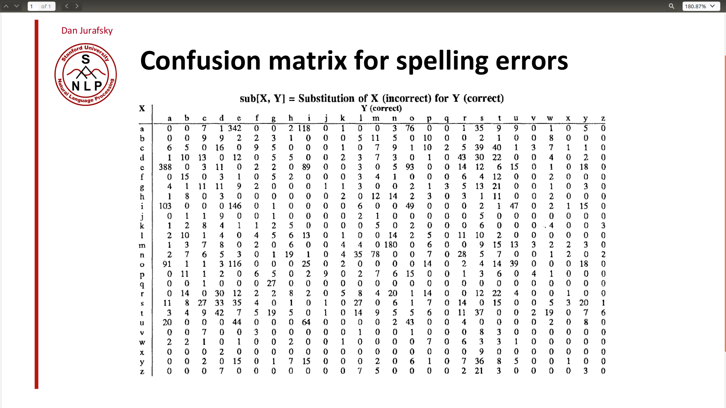

Slide 15
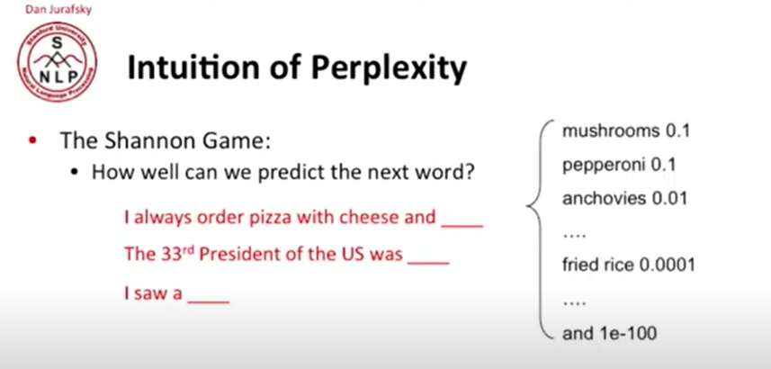
Evaluating Language Model: Perplexity

Slide 16

Approximating Shakespeare

Slide 17
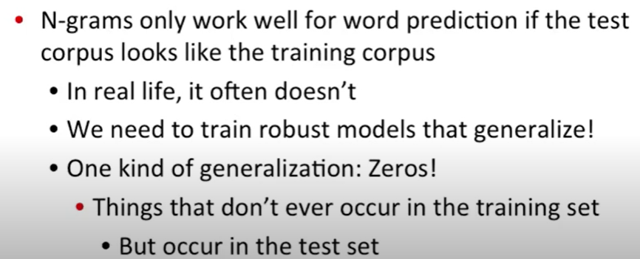
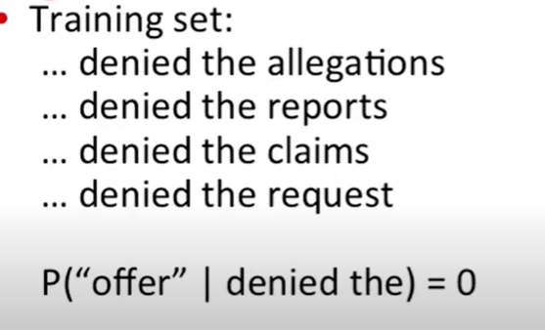
Dealing Zero : Perplexity

Slide 18
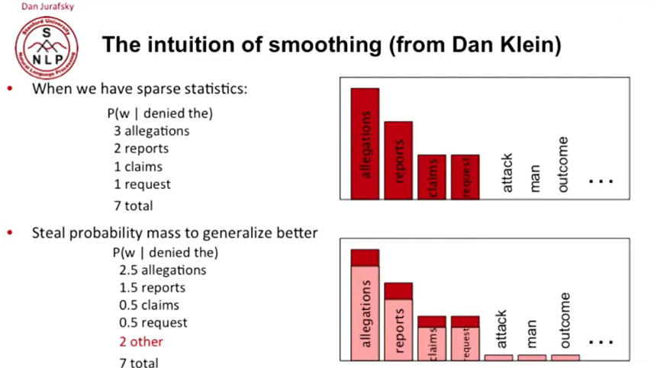

Slide 19
